Slide 1

Analysis of Nexus Shopping Centre Annual Report 2025: An Excel-Driven Insight
Project by: Harsh Vardhan Pareek
Date: 14-06-2025
Leveraging Microsoft Excel for comprehensive financial and operational insights.
HP
by Harsh Vardhan Pareek

Slide 2

Project Overview & Objectives
Nexus Shopping Centre aims to create a 2025 annual sales report. This will help them understand customers for 2026 growth.
Gain Insights Into:
Tools & Goals:
Store performance
Microsoft Excel was used for data cleaning, processing, analysis, and visualization.
Customer footfall trends
Occupancy & leasing data
Our goal is to provide actionable insights for strategic decisions and future growth.

Slide 3
Methodology & Excel Application
Pivot Tables
Pivot Charts
Data Cleaning
Summarized large datasets efficiently.
Visualized performance trends clearly.
Removed duplicate entries effectively.
Filtered category-wise and time-based trends.
Compared year-over-year and month-over-month growth.
Handled null values for data integrity.

Slide 4
Sample Questions & Analysis Focus
Our analysis focused on key questions to drive insights.
Compare sales and orders using a single chart.
List top 10 states contributing to sales.
Relation between age and gender based on orders.
Which month had the highest sales and orders?
Which channel contributes to maximum sales?
Who purchased more: men or women in 2022?
What is the highest selling category?
What were the different order statuses in 2022?

Slide 5
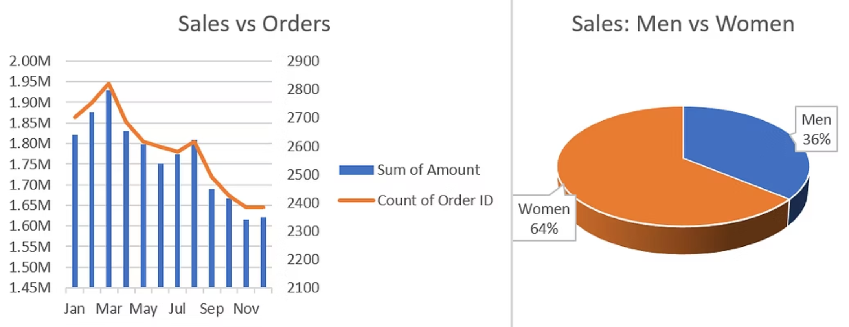
Sales & Orders – Monthly Trend + Gender Insights
March saw peak sales and the highest number of orders.
Sales and orders steadily declined from April to November.
Women drove 64% of sales, significantly outperforming men (36%).

Slide 6
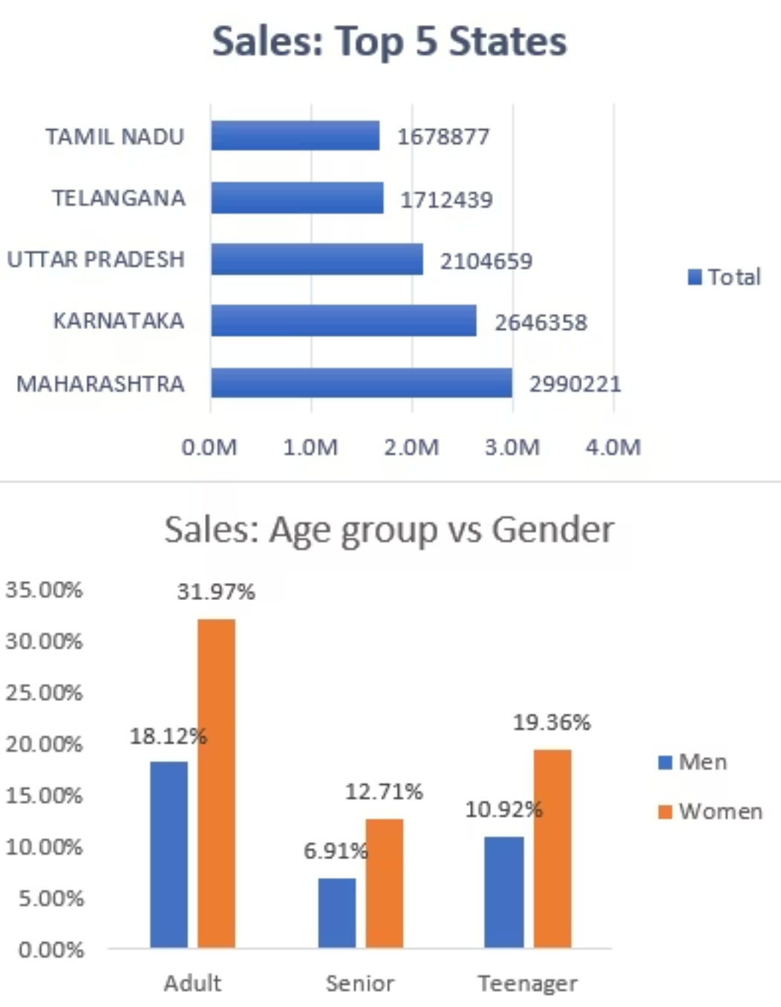
Top Performers & Target Segments
Maharashtra leads sales (~₹3.0M), with Karnataka and Uttar Pradesh following.
Tamil Nadu and Telangana show significant growth potential.
Adult women (32%) are the top contributors across all segments.
Men’s sales share remains consistently lower across all age groups.

Slide 7
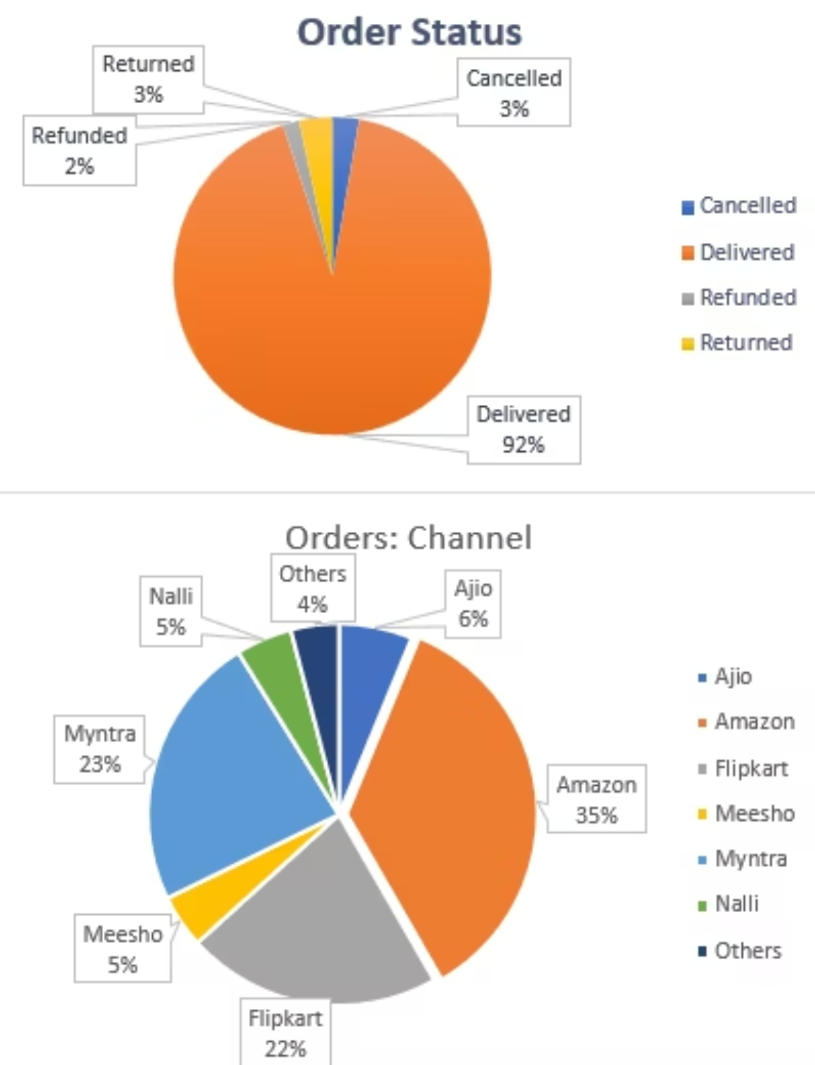
Order Fulfillment & Channel Insights
92% of orders were delivered, showing strong efficiency.
Low dissatisfaction is indicated by only 3% returned, 2% refunded, and 3% cancelled.
Amazon leads in orders (35%), followed by Myntra (23%) and Flipkart (17%).
Ajio, Meesho, and Naali account for smaller shares,
around 5–6% each.

Slide 8
Key Strategic Insights & Recommendations
1
Sales & Orders
Sales peaked in March, declining afterward.
Recommendation: Boost retention with loyalty offers and seasonal campaigns.
2
Gender Insights
Women, especially adult women, drive 64% of sales.
Recommendation: Focus on women-centric marketing and festive promotions.
3
Top States
Maharashtra, Karnataka, and UP lead in sales.
Recommendation: Invest more in top states, expand in lower-performing regions.
4
Age Group Targeting
Adults are the top buyers, particularly women.
Recommendation: Personalize offers by age group; use social media for teens.
5
Order Fulfillment
92% delivered successfully; low return/cancel rates.
Recommendation: Promote reliable delivery; reduce remaining 8% issues.
6
Channel Performance
Amazon (35%) and Myntra (23%) dominate.
Recommendation: Prioritize top channels; optimize weaker platforms.

Slide 9
CONCLUSION AND PROJECT LINK TO GITHUB
Adult women are the highest contributing customer segment.
Amazon and Myntra are the top-performing platforms.
Maharashtra, Karnataka, and Uttar Pradesh lead in sales performance.
High delivery success rate of 92% indicates strong operations.
Growth potential exists in underperforming regions and platforms.
Data-driven strategies can enhance customer retention and sales.
GitHub Project Link: https://github.com/harsh187analysis/Nexus_Store_Excel_Analysis/tree/main

